Slide 1
Water resources, social value, and institutions
Rivers and wetlands protection and regulation

Slide 2
Updates/ announcements
Study guide posted
For the first module make sure to look at lecture slides too
Suggestions for staying self motivated?
Hands-on activities –sign up for both
Suggestions for the course – more quizzes, lectures cut off, overall positive feed back
26 Freshman
13 Sophomores
Japan
3 from CA, 1 CT, 1 FL
“Able to grocery shop and not check my bank account before hand”

Slide 3
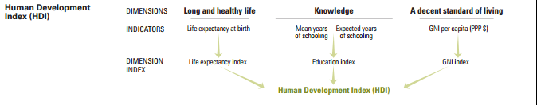
From last class HDI
The Human Development Index (HDI) is a summary measure of average achievement in key dimensions of human development: a long and healthy life, being knowledgeable and have a decent standard of living. The HDI is the geometric mean of normalized indices for each of the three dimensions

Slide 4
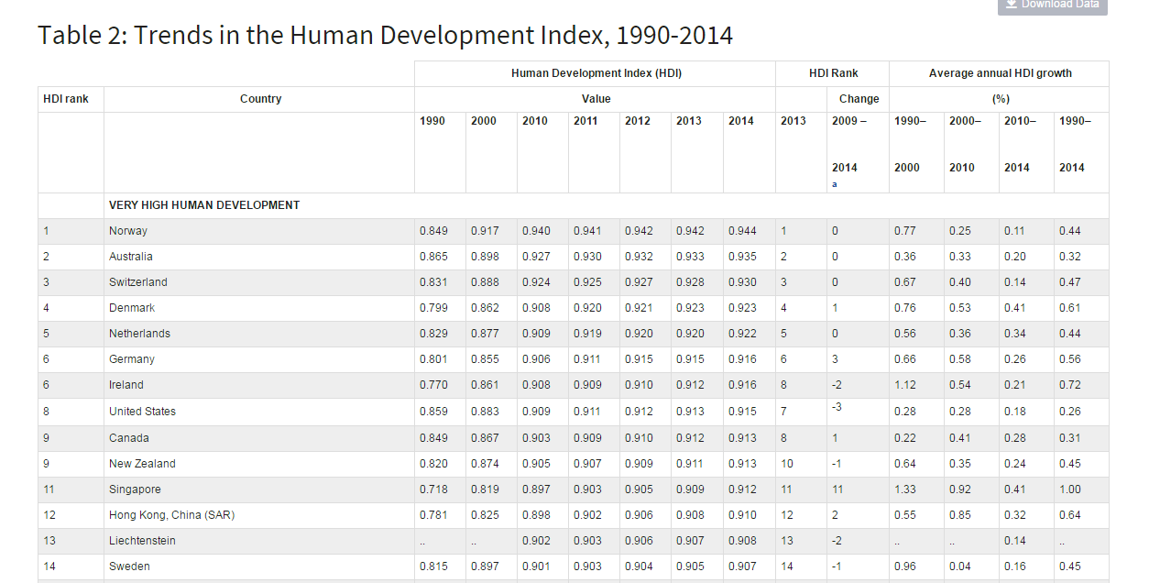
HDI countries with very high ranking

Slide 5
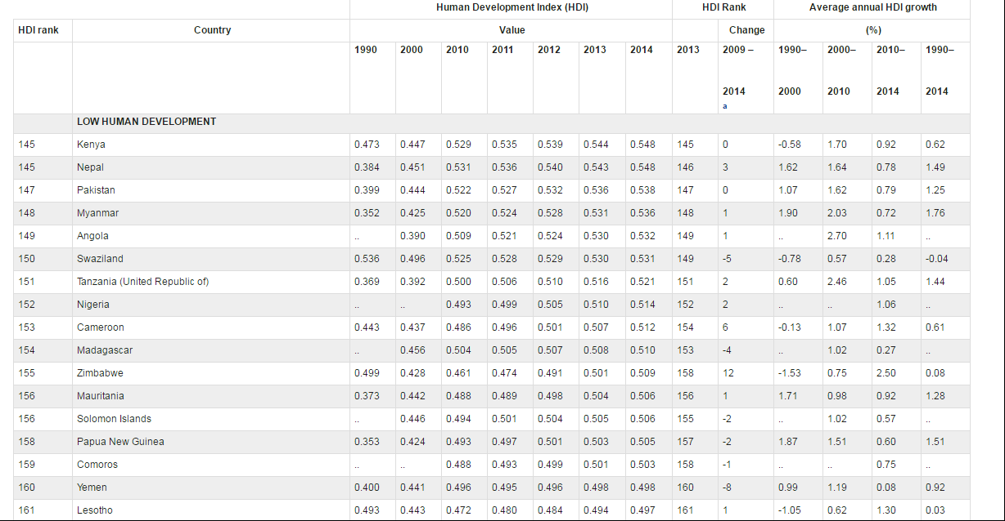
HDI countries with very low ranking

Slide 6
Gini Index
The Gini index is a measurement of the income distribution of a country's residents. This number, which ranges between 0 and 1 (100) and is based on residents' net income, helps define the gap between the rich and the poor, with 0 representing perfect equality and 1 (100) representing perfect inequality.
Is the US closer to 0 or 1 (100)?

Slide 7
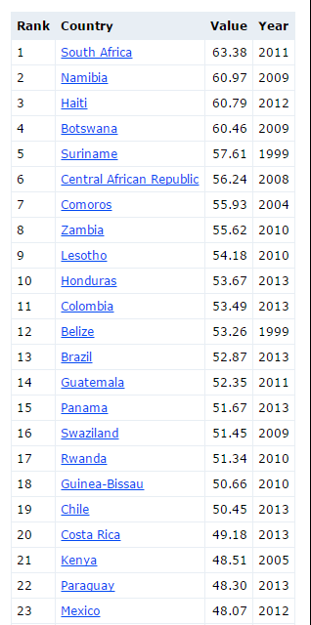
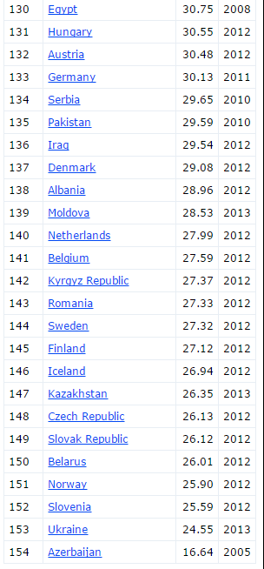
Gini Index (US is #63)

Slide 8
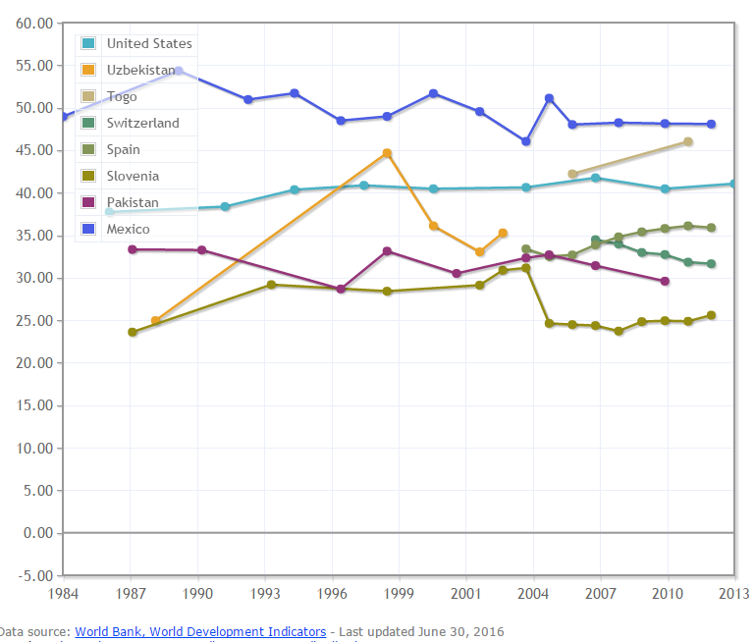
Gini Index
http://www.indexmundi.com/facts/indicators/SI.POV.GINI/compare#country=si:es:ch:tg:us:uz

Slide 9
GDP (From Investopedia http://www.investopedia.com/ask/answers/199.asp)
The gross domestic product (GDP) is one of the primary indicators used to gauge the health of a country's economy. It represents the total dollar value of all goods and services produced over a specific time period; you can think of it as the size of the economy.
Measuring GDP is complicated (which is why we leave it to the economists), but at its most basic, the calculation can be done in one of two ways: either by adding up what everyone earned in a year (income approach), or by adding up what everyone spent (expenditure method). Logically, both measures should arrive at roughly the same total.

Slide 10
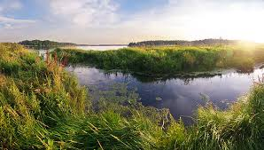
Rivers & wetlands protection and regulation
Changing social value of waters and wetlands
Benefits and costs of managing resources differently (dam removal, coal mining)
Complexities of regulation in the U.S.

Slide 11
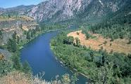
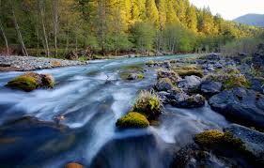
River and Waters Resources
Fishing
Nurseries
Storm Protection
Hunting
Transportation
Power
(hydro and cooling)
Mining
Drinking
Irrigation
Recreation
Ponce.sds.edu
wgal.com
Notes:
Resource use and extraction resource provides protection / benefits if left in tact.
Tradeoffs to managing water resouces

Slide 12
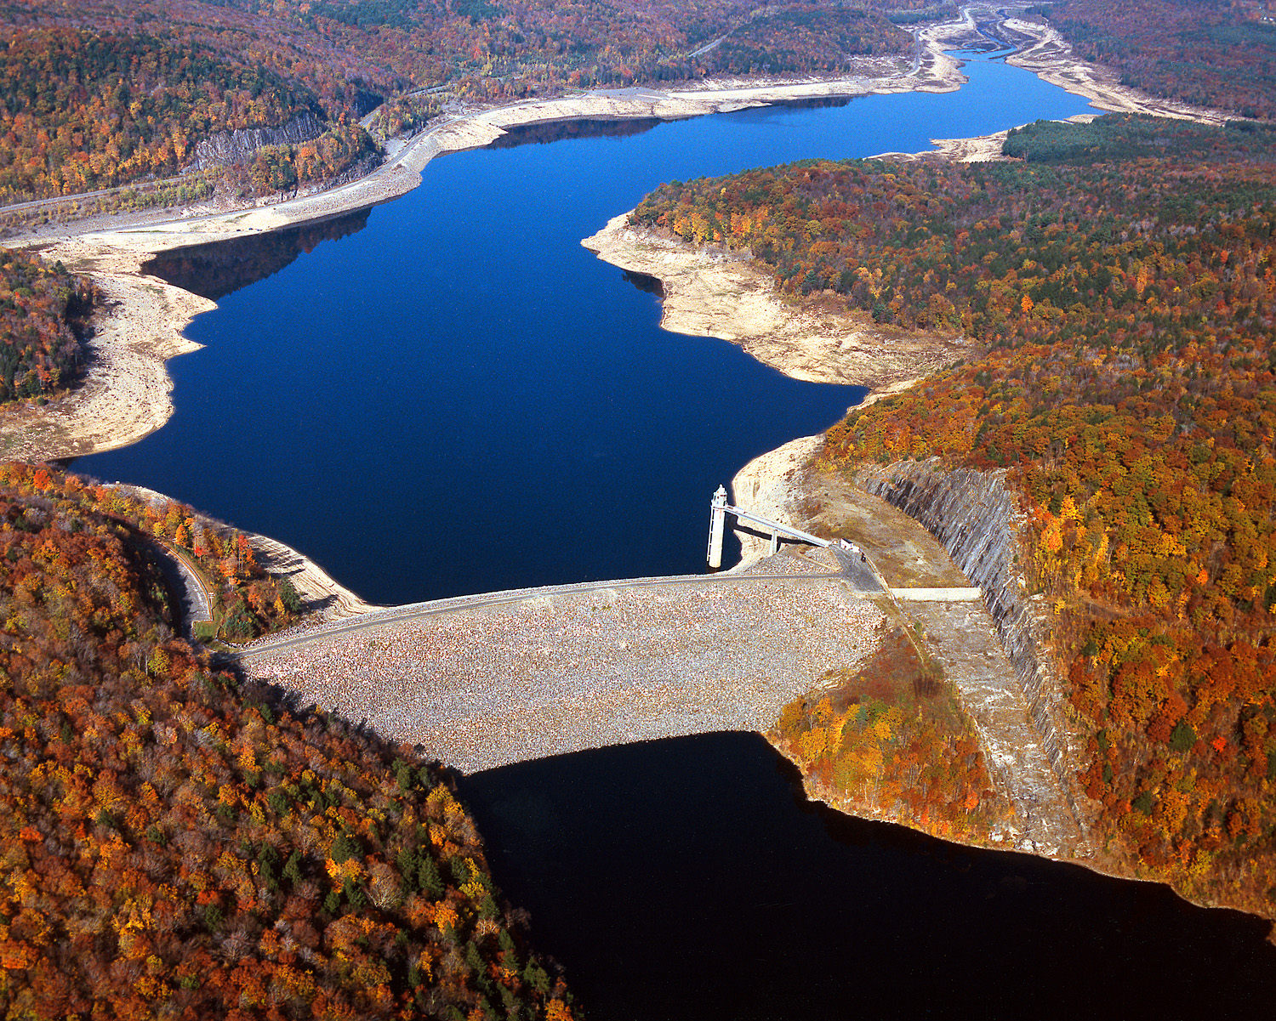
Farmington Dam (CT)

Slide 13
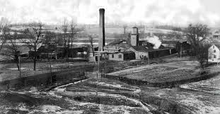
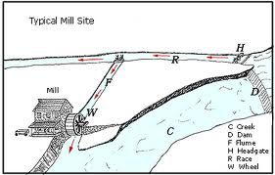
Mill Dams

Slide 14
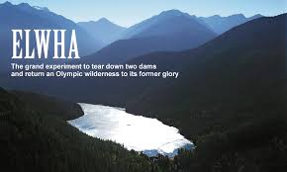
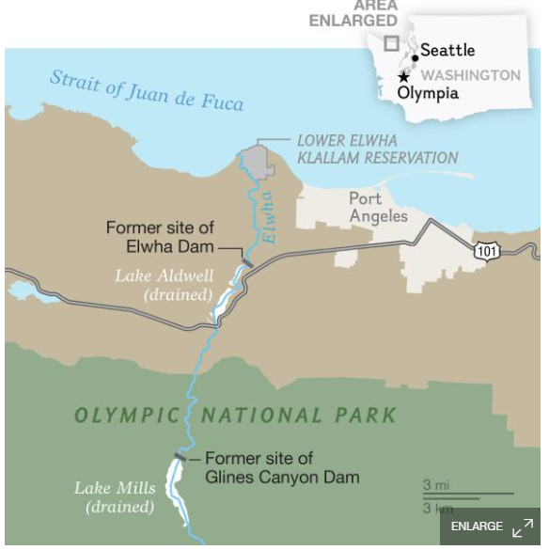
Dam removals in U.S. Elwha largest removal in the world (WA, built 1911)

Slide 15
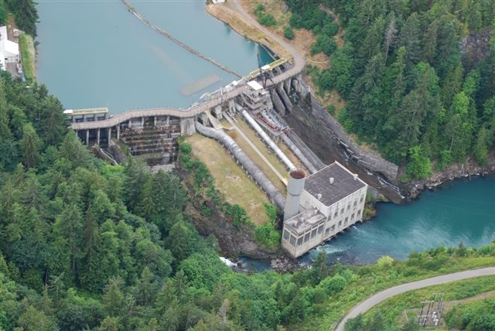
Before

Slide 16
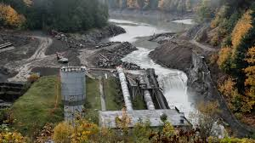
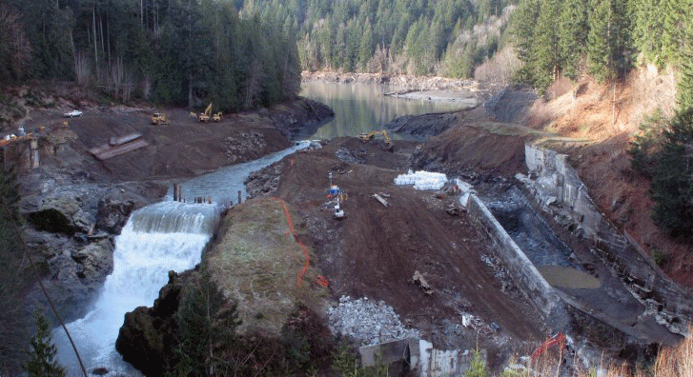
During

Slide 17
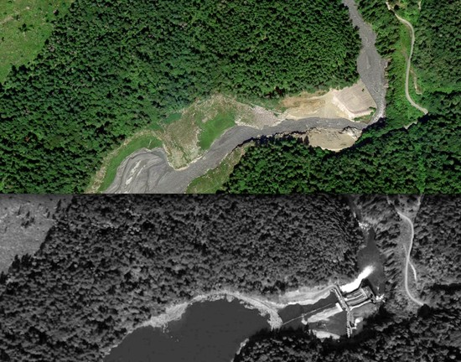
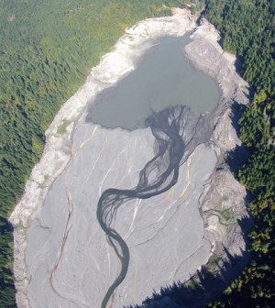
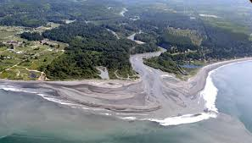
After (2012) http://video.nationalgeographic.com/video/news/160602-us-elwha-river-dam-removal-restoration-vin

Slide 18
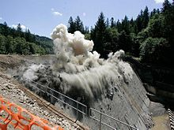
What are costs and benefits of dam removal?
NOAA - http://www.nmfs.noaa.gov/gallery/images/category/dam_removals.html

Slide 19
Benefits and costs of dam removal
Restore fisheries (salmon)
Remove liability
Remove cost of maintenance
Improve recreation (also reduce recreation in reservoir)
Eg. The Condit Dam: cheaper to source “14 megawatts elsewhere, rather than install expensive fish ladders and other improvements on the site, as would have been required for relicensing. According to the AP, the dam removal cost around $32 million, while the improvements would have cost $100 million.”
(http://news.nationalgeographic.com/news/2011/10/111028-condit-dam-removal-video/)

Slide 20
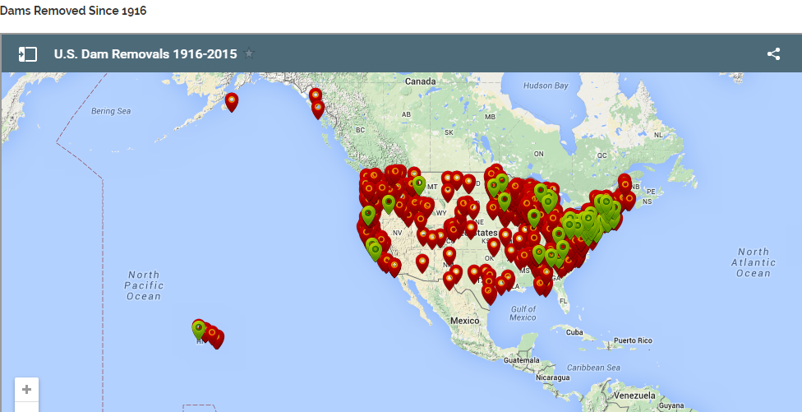
American Rivers.org
79,000 dams in the US
2,540 hydropower dams

Slide 21
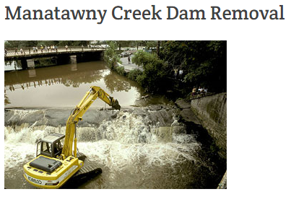
Manatawny Dam Removal Pottstown, PA
Geomorphology
Stream water Chemistry
Sediment Chemistry
Food Webs
Dissolved Organic Matter
Algae
Freshwater Mussels
Macroinvertebrates
Fish

Slide 22
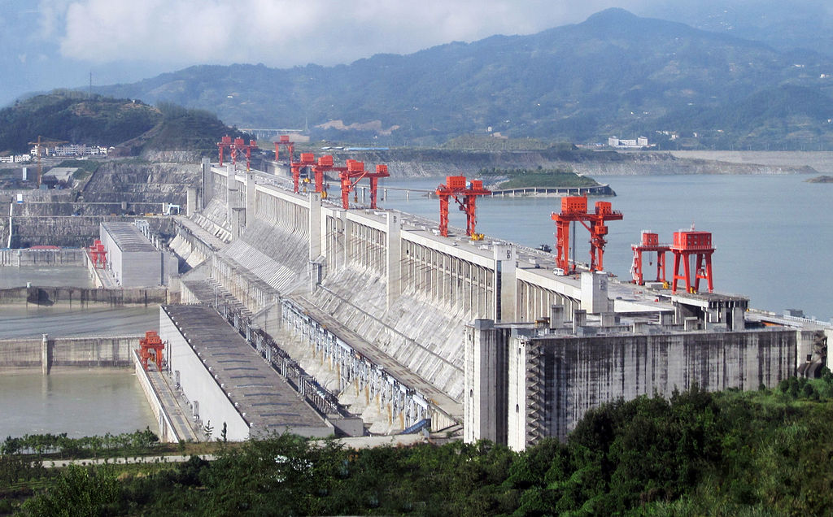
Three Gorges Dam, China (22,550 MW)

Slide 23
Question
Has the “social value” of rivers and wetlands changed over time?

Slide 24
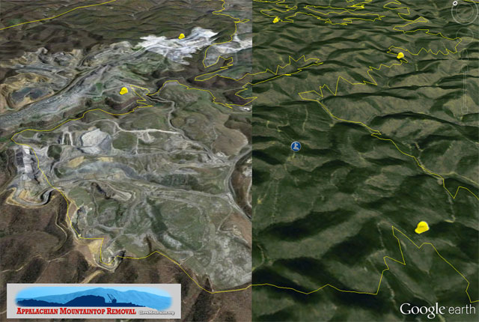
Mountaintop removal, WV

Slide 25
Rivers and waters
Sign of prosperity “Hartig chronicles the rise of Great Lakes industrialization in the early and mid 20th century when the lakes and their tributaries were considered public sewers and waste disposal lagoons. ‘Industry was king,’ he writes, ‘and dirty rivers were considered a sign of prosperity.’”
Michigan Environmental Report - July 2011 Online
When our rivers caught fire
John Hartig’s book chronicles fires on horrifically polluted Rouge River and three others, and the public outcry that stopped them

Slide 26
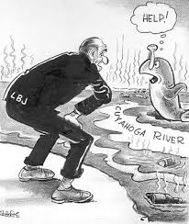
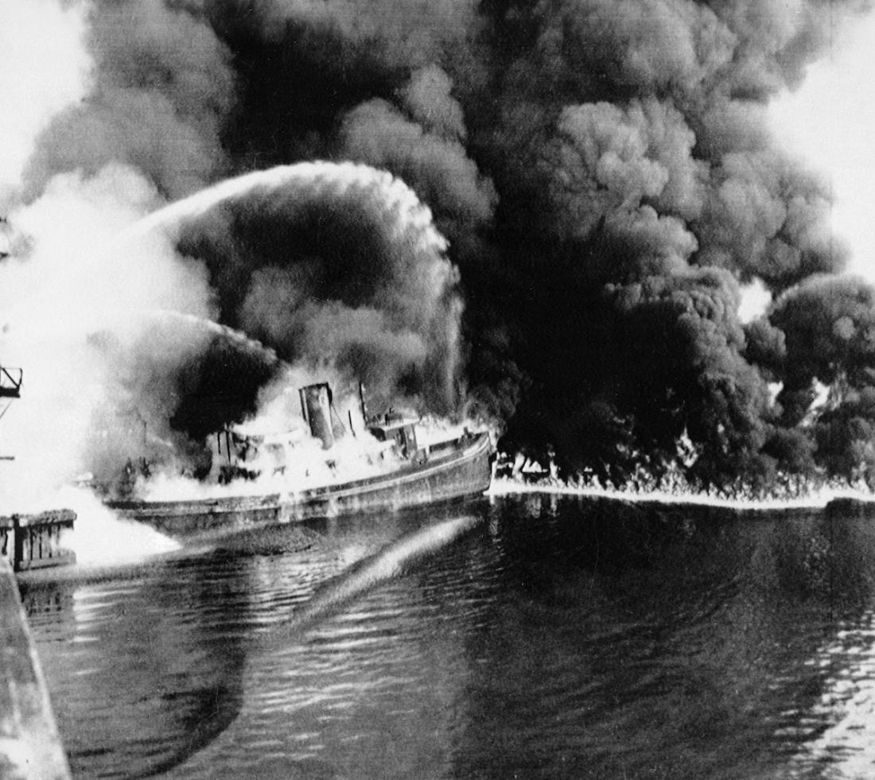
Rivers- Chicago Cuyahoga caught fire multiple times
Pophistorydig.com
time.com

Slide 27
Rivers: Michigan Environmental Report - July 2011 (When our rivers caught fire by John Hartig)
“In 1969, shortly after the notorious Cuyahoga River fire, the oil-matted Rouge River in Detroit caught fire, shooting flames 50 feet in the air and sending smoke billowing near the I-75 highway bridge.”
“’The 1969 Rouge River fire didn’t get much local media attention,’ Hartig writes. “Most citizens accepted the fires as part of the industrial operations that brought jobs to the area.’”

Slide 28
“When our rivers caught fire” by John Hartig
Sewage, too
“Adding to the industrial pollution was a torrent of sewage flowing into the Rouge and other waterways. Mats of dense fecal matter mixed with condoms and other unmentionables joined the oil sludge in a macabre cocktail of toxicity. In 1985, a 23-year-old man died from a rare parasitic waterborne disease (leptospirosis) after falling into the river and swallowing water.
This sewage issue was personal for Hartig, who grew up in an Allen Park home where nothing of value was ever stored in the basement: ‘Sewage would back up in our basement,’ as a result of the inadequate system. The sewage ‘…created an odor problem and literally a public health hazard. We had to use muriatic acid to disinfect our basement.’”

Slide 29
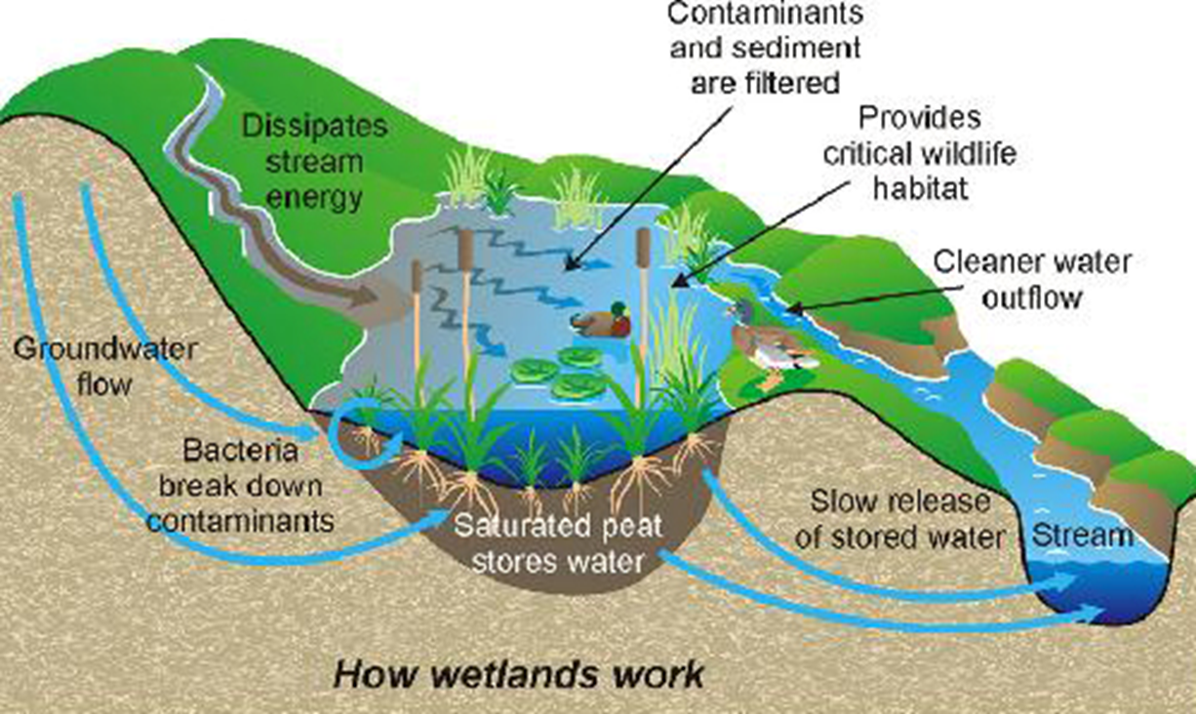
What are wetlands?
Image courtesy of the City of Caspar, Wyoming http://www.adammandelman.net/
Notes:
Wetlands were once thought to be wasteland areas to be filled, drained, ditched and were more valuable when they were dry land (www.water.epa.gov). Disease carrying insects also breed in wetlands so, in early America, filling wetlands was necessary to reduce malaria and other mosquito borne disease. Over half of wetlands in America have been filled or drained (www.water.epa.gov).

Slide 30
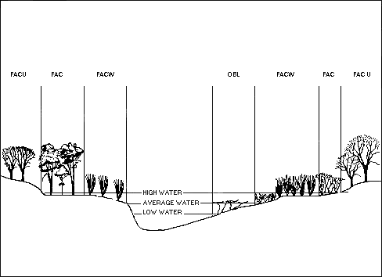
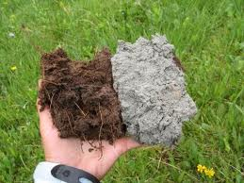
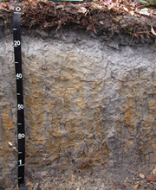
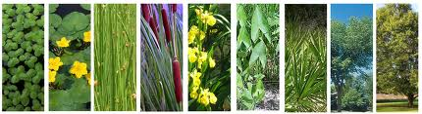
What is a wetland? Three components: Vegetation Soils Hydrology
Image from USACE
http://www.spk.usace.army.mil
Images from ww.nps.gov and www.soil.ncsu.edu
bolinq.wordpress.com

Slide 31
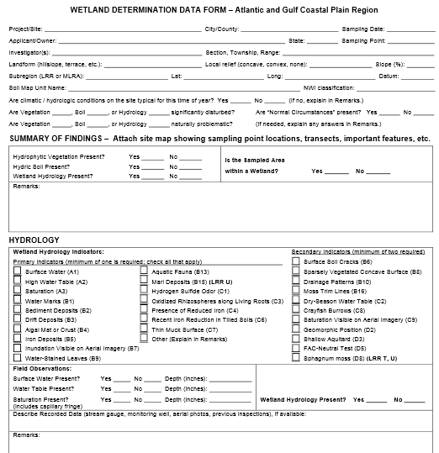
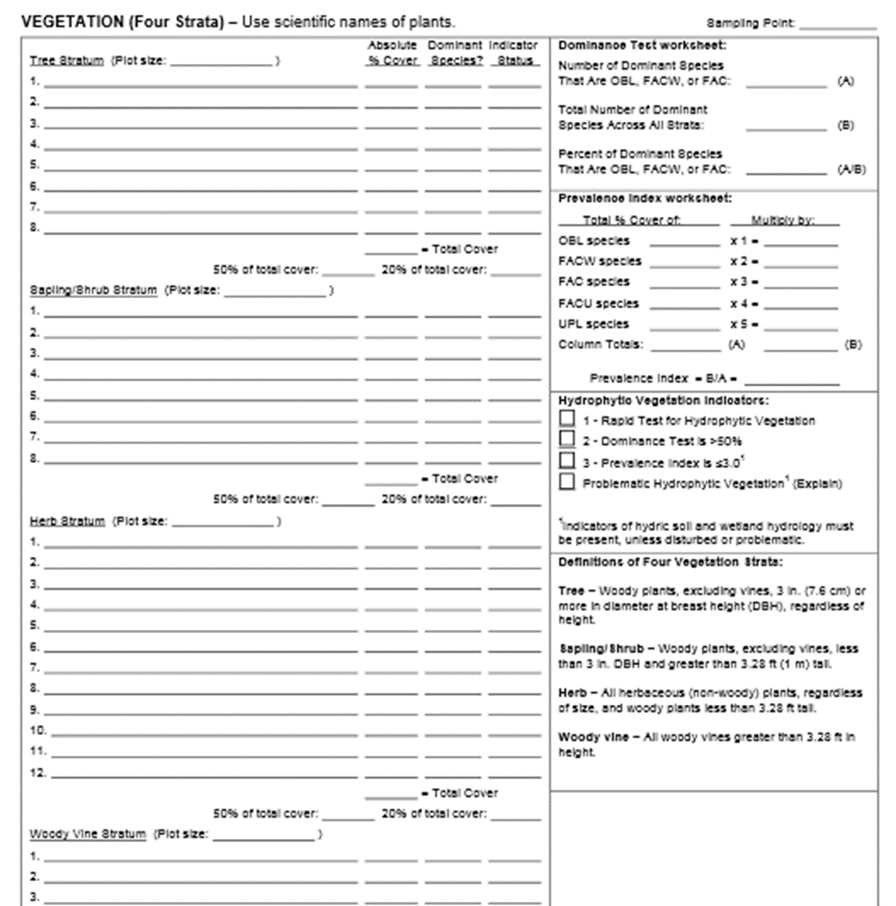
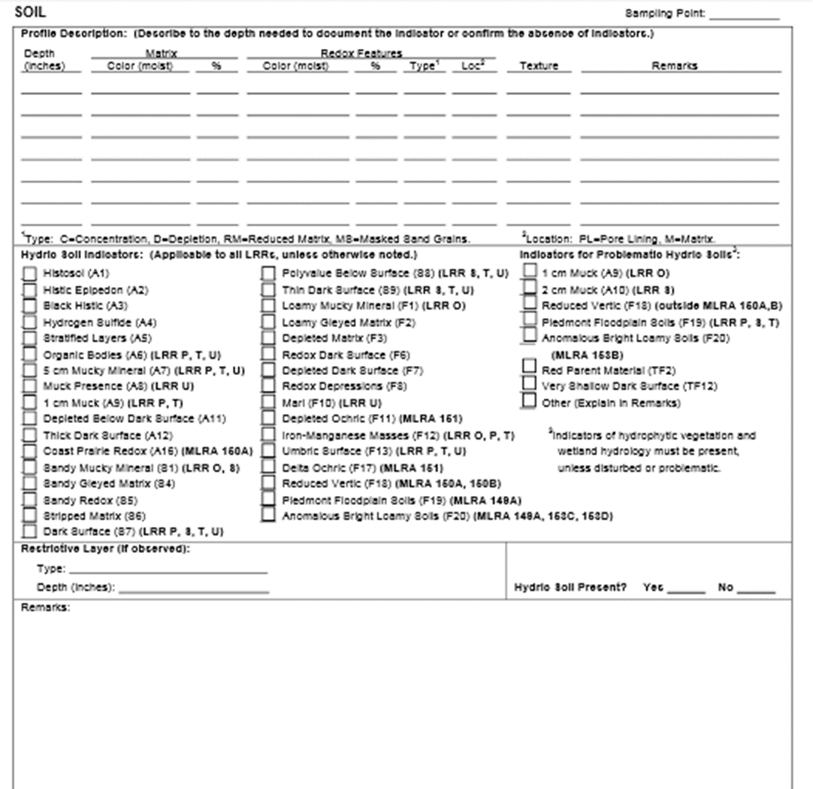
A lot of tiny words that you cannot read
HYDROLOGY VEGETATION
SOILS

Slide 32
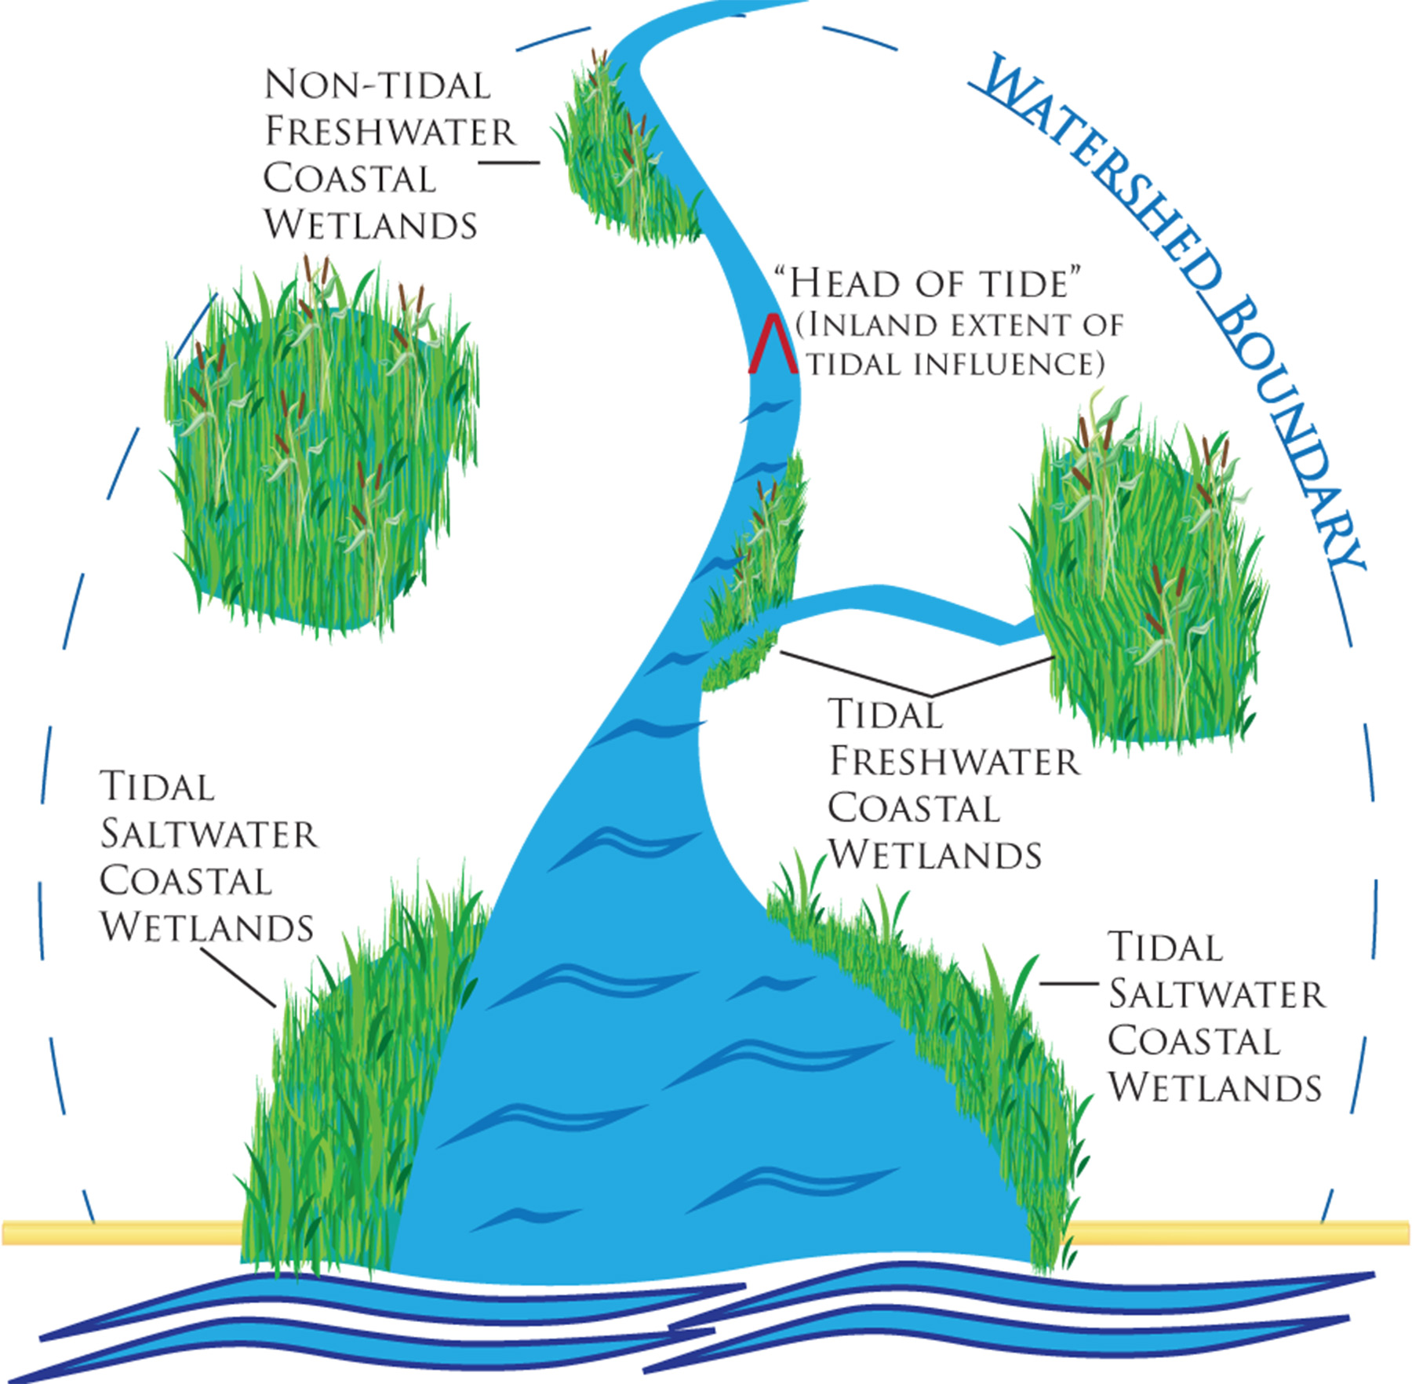
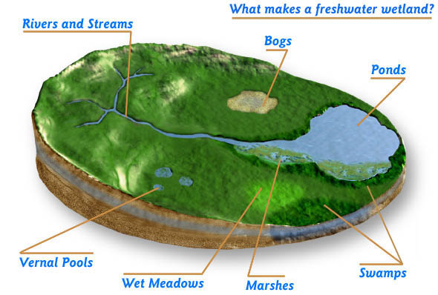
Wetlands different names and functions
Images www.epa.gov, www.dem.ri.gov
Notes:
Simply - there are many types of wetlands called by different names for scientific purposes.

Slide 33
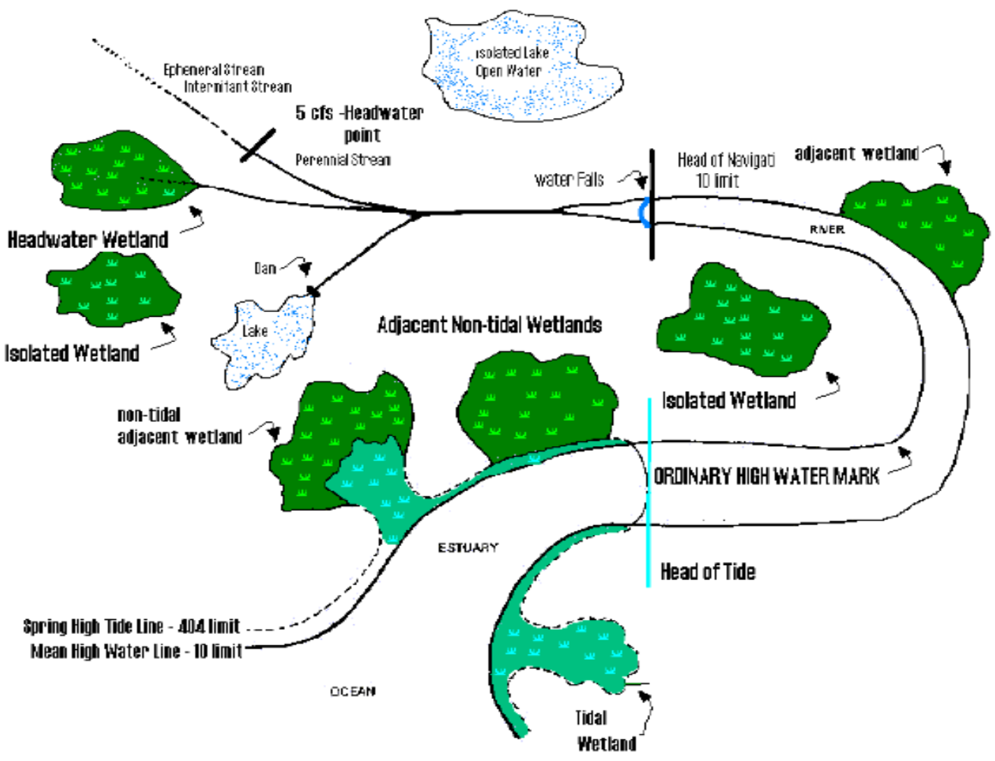
Wetlands with “connectivity”
Notes:
More complicated is the jurisdictional (regulatory) definitions of wetlands. These definitions depend on science and law.
When I completed wetland delineations, I would also flag areas that were Waters of the US, and waters under state jurisdiction.
After I completed my report, representatives from the state and US Army Corps of Engineers would come to verify my “line.”
The current rule attempts to clarify isolated waters, and their function in the landscape.

Slide 34
Wetlands as dangers to society
“America's affluence was a major asset. Almost everyone could get to a doctor; windows could be screened; resources were available to bulldoze mosquito-breeding swamps.” (http://ngm.nationalgeographic.com/ngm/0707/feature1/text3.html)
“They began with land reclamation and permanent improvements in rural housing, turning malarious wastelands such as the Pontine Marshes into profitable agricultural zones.”
“…early part of the Twentieth Century to control malaria through larviciding, health education, case detection with rapid treatment, by careful water management, and by ditching malarious swamps to convert them into productive agricultural use (Greenberg and Alexander 2011. “Israel Jacob Kligler” in Korot, Jerusalem).”

Slide 35
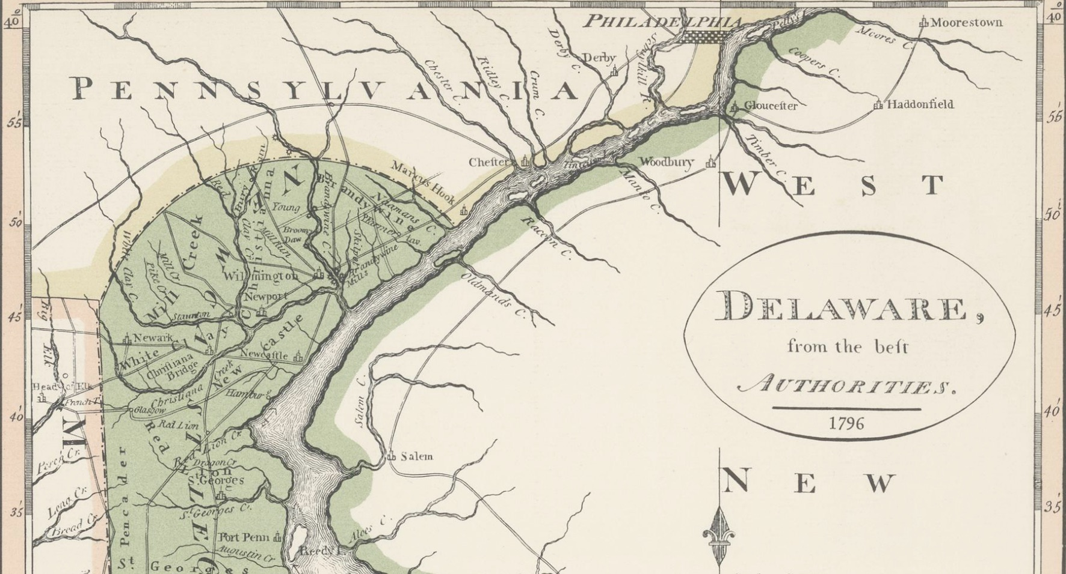
“Waste-land” to “Waste storage” Wilmington – Cherry Island Landfill

Slide 36
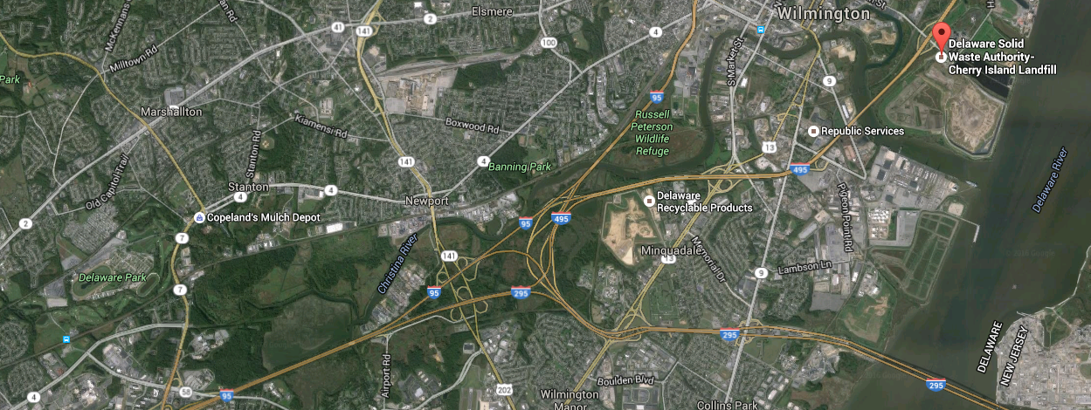

Slide 37
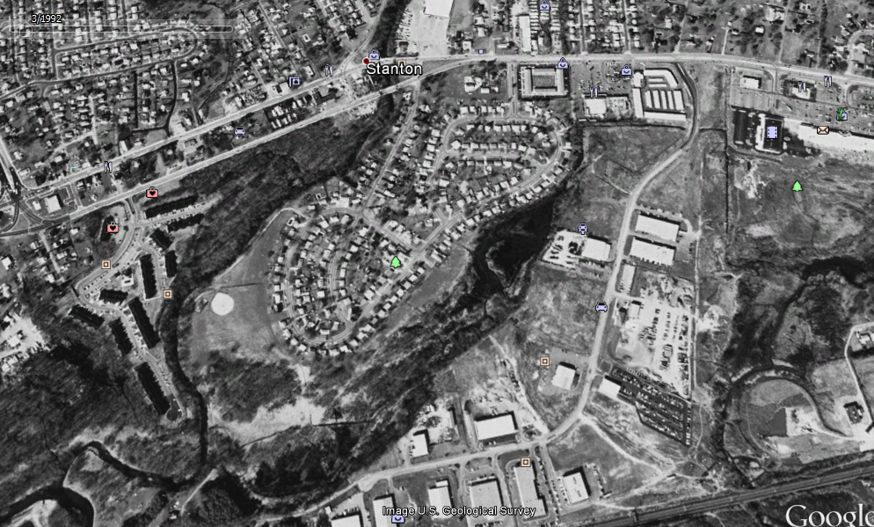
Glenville, Delaware (1992)

Slide 38
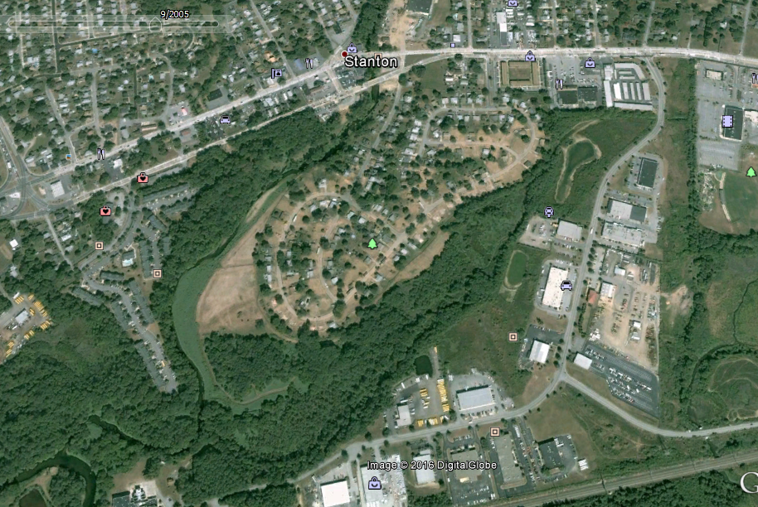
Glenville, Delaware (2005) Hurricane Jeanne (2004)

Slide 39
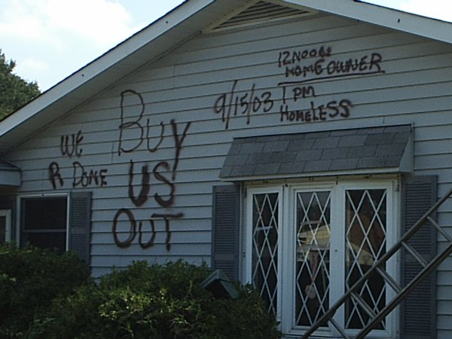
Repeated flooding homes condemned

Slide 40
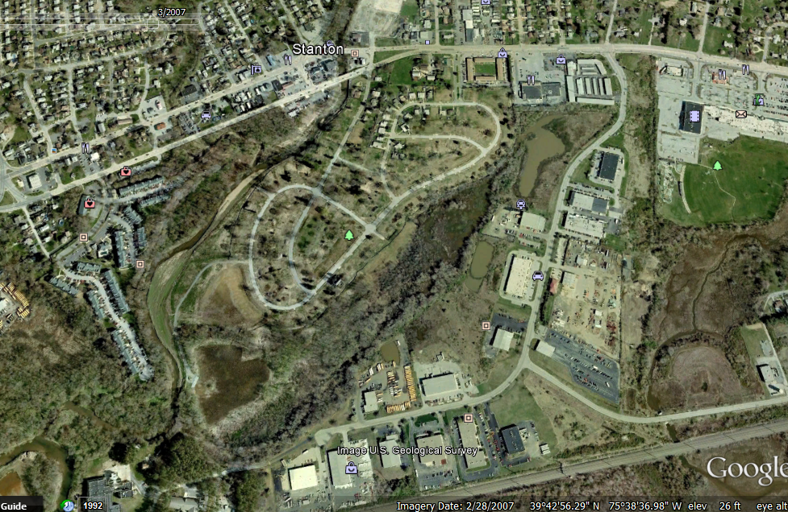
Glenville 160 homes bought by FEMA (2007)

Slide 41
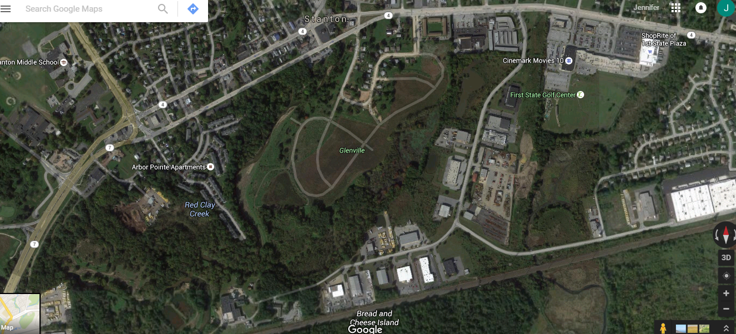
Glenville today

Slide 42
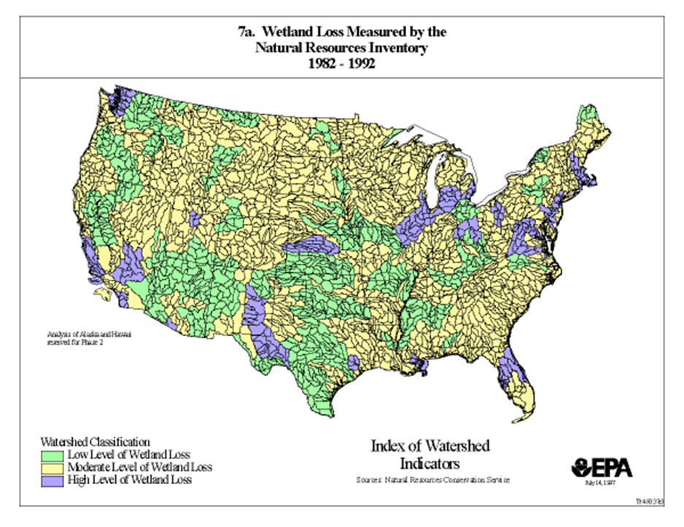
Wetland loss in the U.S.

Slide 43
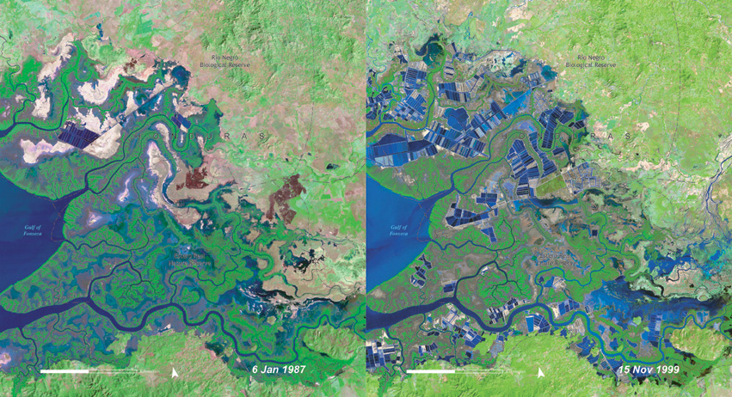
Honduran Shrimp Farms
http://www.grid.unep.ch/activities/global_change/atlas/images/honduras_s.jpg

Slide 44
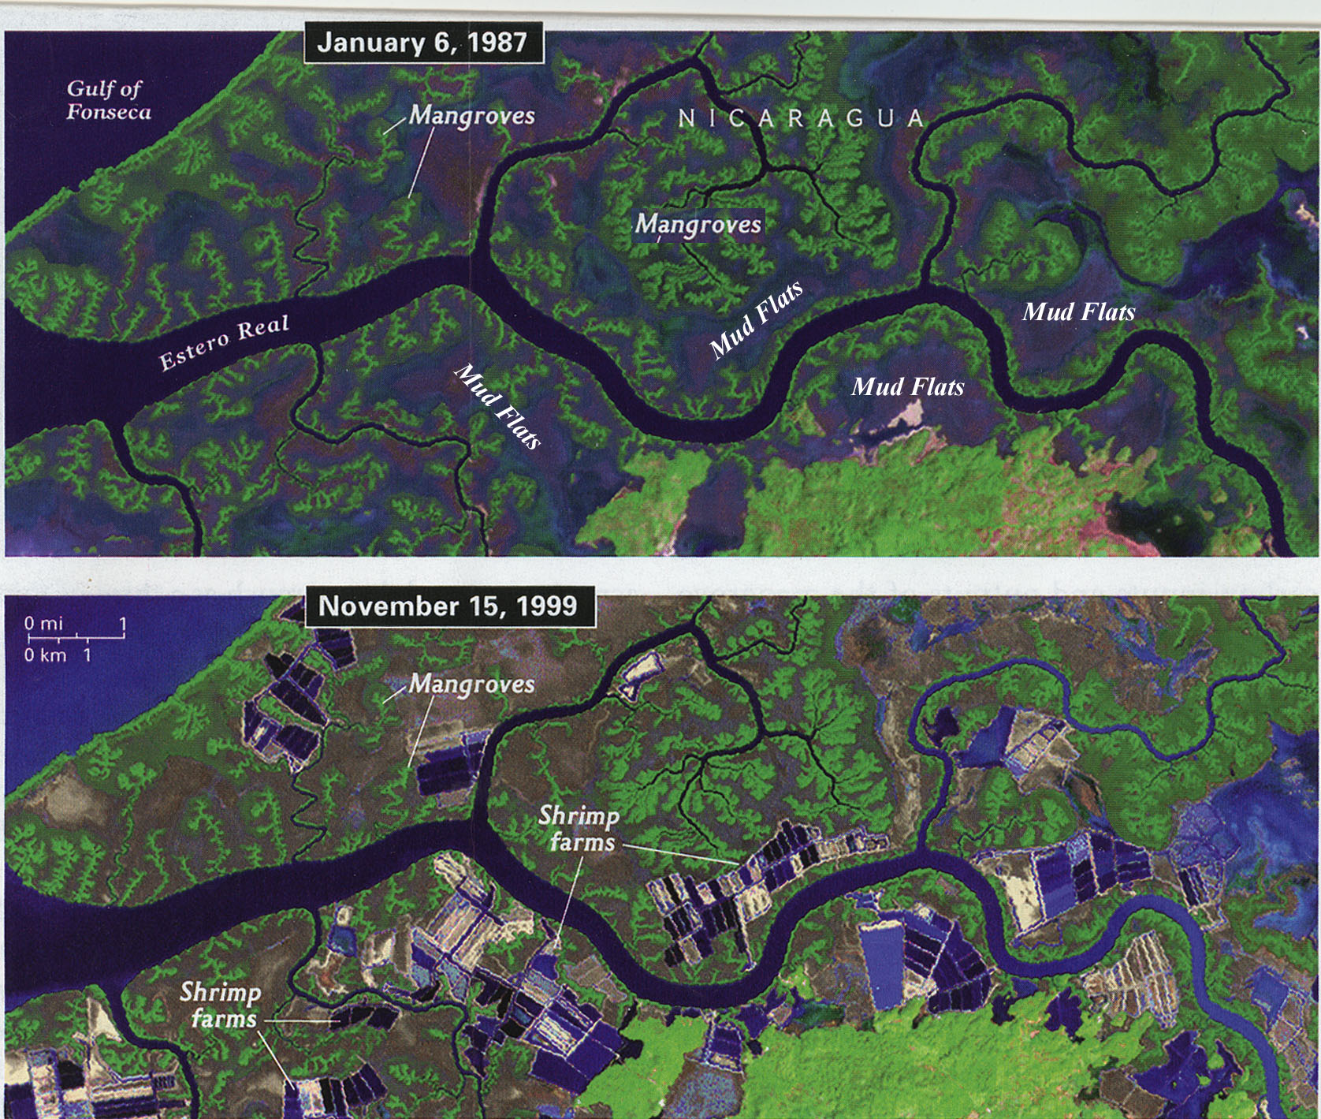
Nicaragua

Slide 45
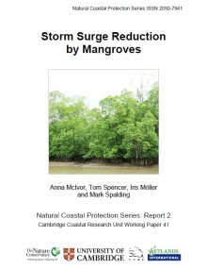
Mangroves provide benefits if left intact for local communities

Slide 46
Rivers and wetland valuation
Has the “social value” of rivers and wetland changed over time?
Yes- however, there are still problems with protecting waters and wetlands.

Slide 47
How Wolves Change Rivers
How Wolves Change Rivers – YouTube (4:34)
https://www.youtube.com/watch?v=ysa5OBhXz-Q

Slide 48
What are ecosystem services? (UNEP http://www.unep.org/maweb/documents/document.300.aspx.pdf)
The benefits people obtain from ecosystems. These include:
provisioning services such as food and water;
regulating services such as flood and disease control;
cultural services such as spiritual, recreational, and cultural benefits; and
supporting services, such as nutrient cycling, that maintain the conditions for life on Earth.

Slide 49
Ecosystem services Pendleton (2014)
Why is ecosystem services valuation is used?
Helps with decision making processes
Policy formation
Helps include ecosystems as if they “matter”

Slide 50
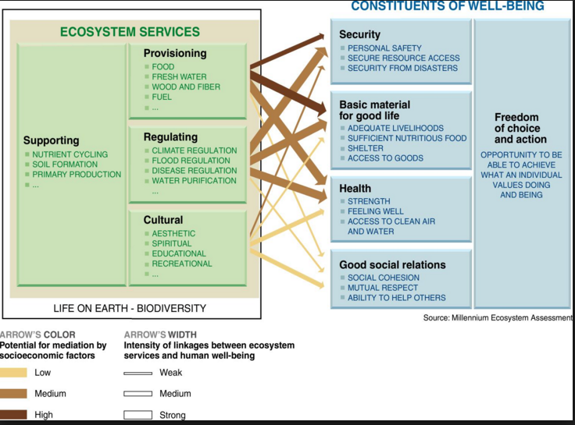
Ecosystem services (use and non-use benefits)

Slide 51
Pendleton (2014)
What are some problems with quantifying ecosystem services?
Placing a number on everything does not make policy better
Vagueness
Differing interests and values
When things are irreplaceable or damage is irreversible valuation should not be use

Slide 52
What services do wetlands provide?
Image courtesy of the City of Caspar, Wyoming http://www.adammandelman.net/
Notes:
Wetlands were once thought to be wasteland areas to be filled, drained, ditched and were more valuable when they were dry land (www.water.epa.gov). Disease carrying insects also breed in wetlands so, in early America, filling wetlands was necessary to reduce malaria and other mosquito borne disease. Over half of wetlands in America have been filled or drained (www.water.epa.gov).

Slide 53

Which services are easy to quantify (i.e. put a $$ number on)?

Slide 54

UN Food and Agriculture Organization

Slide 55
Laws to protect property, humans and water resources
Flood Protection Acts (1968, 1973)
Federal Water Pollution Control Act
and Amendments (1948)
“Clean Water Act” (1972)
Law (statute) Agency Regulation
Standards
Guidance
Rules
The U.S. Supreme Court

Slide 56
Agencies that administer laws that protect water resources
President
of the
United States
Department
of
Defense
Department
of
Interior
Environmental Protection
Agency
Department
of
Agriculture
Department
of
Energy
Department
of
Commerce
Dept. of
Homeland
Security
U.S. Army
Corps of
Engineers
U.S.
Geological
Survey
Natural
Resources
Conservation
Service
Federal
Energy
Regulatory
Commission
Coastal Zone Management
U.S.
Coast
Guard
U.S. Fish
& Wildlife Service
U.S.
Forest
Service
National
Marine
Fisheries
Service
Federal
Emergency Management Agency
National
Park
Service
National
Weather Service

Slide 57

Image from USACE
http://www.spk.usace.army.mil
Notes:
The federal jurisdiction overlaps with state jurisdiction. States typically regulate to ordinary high water (OHW) and mean high water (MHW) in tidal areas. Most states also regulated wetlands. Federal CWA and state regulate projects in these areas that are typically filling or constructing crossings or stabilizing the shore line. Wetlands and waters have a definition and sometimes people confuse them. The plans that have both waters and wetlands would have waters of the US with wetlands, or just waters of the US.

Slide 58

Local Protection
Notes:
An example of municipal protection, the City of Newark added riparian and wetland ordinance for its Subdivision and Development Regulations. New Castle County also has protections established in their Unified Development Code (UDC).

Slide 59

State Jurisdiction - Delaware
DNREC Wetlands and Subaqueous Lands
Section (WSLS) jurisdiction below:
Ordinary high water (OHW)
Mean high water line (MHWL) in tidal
wetlands and streams
No jurisdiction over “isolated”
(<400 contiguous acres).
July 2013 SB 78

Slide 60
Image USACE acoe_permits_0308.pdf
USACE www.usace.gov
Notes:
More complicated is the jurisdictional (regulatory) definitions of wetlands. These definitions depend on science and law.

Slide 61
Surrounding States
Maryland and Pennsylvania
Regulatory authority over wetlands, including isolated wetlands and most waterways.
New Jersey
Regulatory authority over wetlands, including isolated wetlands and most waterways
Assumes USACE 404 program for all non-Section 10 waters

Slide 62
US Army Corps of Engineers (USACE) jurisdiction
Fill (or excavation) below the OHW of waters of the U.S.
Fill (or excavation) below the HTL of tidal areas
Wetlands that have a connection to waters of the U.S.
WHAT DOES CONNECTION MEAN?

Slide 63
Waters of the U.S. (WOTUS)
Defined in 33 CFR 328.3(a) and includes:
All Navigable waters
Interstate waters
All other waters (intrastate lakes, rivers,
streams, mudflats, wetlands, etc.) in which the
use, degradation, or destruction could affect
interstate or foreign commerce
Impoundments of waters of the U.S.
Tributaries of waters of the U.S.
Territorial seas
Wetlands adjacent to waters of the U.S.

Slide 64
Section 404 Waters of the U.S.
High Tide Line (HTL) - Determined by tide gage data
Ordinary High Water Mark (OHW)
line on shore or bank established by water fluctuations which occur on regular or frequent basis
OHW is determined by physical evidence, examples include:
clear, natural line impressed on the bank
change in vegetation types
shelving
soil changes
vegetation destruction
presence of debris line

Slide 65
Image from USACE
http://www.spk.usace.army.mil
Notes:
The federal jurisdiction overlaps with state jurisdiction. States typically regulate to ordinary high water (OHW) and mean high water (MHW) in tidal areas. Most states also regulated wetlands. Federal CWA and state regulate projects in these areas that are typically filling or constructing crossings or stabilizing the shore line.

Slide 66
Waters of the U.S.
Man-made drainage ditches or channels excavated from upland areas are not considered waters of the U.S. unless the ditch or channel:
Was constructed through an adjacent wetland
Provides a hydrologic connection between a traditional navigable water (TNW) and an adjacent wetland
Extends the OHW of a water of the U.S.
Is used to reroute the flow of a water of the U.S.
Connects two waters of the U.S.
Supports relatively permanent flows that drain into waters of the U.S.
Notes:
Does the law cover all waters? How about wetlands…?

Slide 67
Waters of the U.S.
Jurisdiction is generally not asserted over:
Swales or erosional features
(e.g., gullies, small washes characterized by low volume, infrequent, or short duration flow)
Drainage ditches, including roadside ditches
Irrigation ditches
Artificial lakes or ponds
(e.g., stock watering, irrigation, settling basins)
Ornamental bodies of water in upland areas

Slide 68
Projects and waters permits
Determine at the “beginning” of a project:
Whether a delineation of waters or wetlands has been conducted
Is the delineation is current (last 5 years)
Was a jurisdictional determination (JD, state and/or federal) has been issued and if it is current
If a permit is necessary for project components

Slide 69
Projects and waters permits
Federal and state process (some “joint” process)
Public notice, Consistency with:
Permit Issued sometimes with conditions (“no net loss”)
“no findings”
Re-design re-submit
Permit denied
CZMA, CMP, 106 Historic, NMFS, ESA (CNA), WSRA
Permits necessary
Permits not necessary
Notes:
CWA/RHA governs Federal process state laws govern state process sometimes joint processes are approved for specific activities. Public notice comment period, ESA surveys bog turtle, can design to “avoid” the resource. During the permit process the USACE is required to confirm that the project is consistent with other federal laws. When the USACE issues permits it has to prove that all of the other agency rules were followed including historic preservation, endangered species etc.

Slide 70
JDs under the CWA
Influenced by two major court cases:
1) Solid Waste Agency of Northern Cook County
(SWANCC) Decision in 2001
*Invalidated the use of the “migratory bird rule”
2) Rapanos Decision in June 2006
*Five separate opinions were issued, no majority
Guidance:
USACE JD guidance in July 2007, revisions
issued in December 2008
USACE Preliminary JD guidance in July 2008
EPA draft guidance on identifying waters protected by the Clean Water Act, 2011

Slide 71

Science supporting wetlands and waters protection

Slide 72
Rapanos (2006)
Justice Scalia stated that “waters of the United States” extended beyond traditional navigable waters to include “relatively permanent, standing or flowing bodies of water” and only wetlands with a “continuous surface connection” to other jurisdictional waters are considered “adjacent”
Justice Kennedy’s concurring opinion “waters of the United States” included wetlands that had a “significant nexus” to traditional navigable waters
The four justices who signed on to Justice Stevens’ opinion would have upheld jurisdiction under plurality or Justice Kennedy's opinion

Slide 73
JDs 2007/2008/ 2011 guidance
EPA and USACE will continue to assert jurisdiction over:
Traditional navigable waters (TNW)
Wetlands adjacent to TNWs
Non-navigable tributaries of TNWs that are relatively permanent waters (RPW)
Wetlands that abut RPWs
EPA and USACE will decide jurisdiction based on a fact-specific analysis to determine if a “significant nexus” with a TNW is present for all:
Non-navigable tributaries that do not exhibit relatively permanent flows (non-RPW)
Adjacent/abutting wetlands to these non-RPW tributaries

Slide 74
Significant nexus with a TNW
Determined by the presence of a: – Chemical connection – Biological connection – Physical connection – Historical connection
Includes consideration of hydrologic and ecologic factors
A significant nexus is defined as “more than a speculative or insubstantial connection”
Important Definitions:
Abutting – having a shared boundary (i.e., continuous surface connection)
Adjacent – “bordering, contiguous, or neighboring.”

Slide 75


Wetlands adjacent to RPW flowing into TNW
Both areas jurisdictional by significant nexus test
Images from Smith Hartvigsen Attorneys at Law

Slide 76
Significant Nexus Test
Owner Agent collects data, prepares and submits delineation with professional opinion
USACE PM reviews opinion and comments
Comments, questions, more data
Comments, questions, more data
District sends opinion to USACE HQ and USEPA for final approval or rejects opinion
District office reviews and accepts the opinion or returns it to the PM

Slide 77
Proposed rule….

Slide 78

Questions?

